Slide 1
MINOR PROJECT ON AUTO COLLEGE BELL WITH TIMETABLE DISPLAY Presented by Rashmita rout(2101298335)
UNDER THE GUIDANCE OF
Prof. Monalisa samal
Department of electronic and communication engineering
Gandhi institute for technology
An autonomous institute

Slide 2
CONTENTS
INTRODUCTION
OBJECTIVES
COMPONENT REQUIRED
CIRCUIT DIAGRAM
WORKING PRINCIPLE AND VIDEO
WORKING CODE
ADVANTAGES AND DISADVANTAGES
LIMITATION
APPLICATION
CONCLUSION

Slide 3
INTRODUCTION
In today's educational institutions, efficient management of time and schedules is crucial for ensuring smooth operations and enhancing productivity. Traditional methods of managing bells and schedules often lead to inefficiencies and discrepancies. To address these challenges, our project proposes the implementation of an Automatic College Bell System with Timetable Display. This system aims to automate the process of signaling class changes, breaks, and other scheduled events, while also providing real-time timetable information to students, faculty, and staff.

Slide 4
OBJECTIVES
Automation:
Replace manual bell ringing with an automated system to ensure precise timing and reliability.
Timetable Display:
Implement digital displays in key locations throughout the campus to show current and upcoming schedules.
Flexibility:
Allow administrators to easily update and customize the timetable based on semester schedules, events, and other factors.
Integration:
Explore opportunities to integrate the bell system with existing campus management systems for seamless operation.
Enhanced Communication:
Improve communication between stakeholders by providing clear and timely information about schedule changes and events.

Slide 5
COMPONENT DESCRIPTION
Arduino Uno R3
Relay 5V
20 X 4 LCD
LCD 12C
Buzzer
12V Adapter
Jumper Wires
RESET BOTTEN

Slide 6
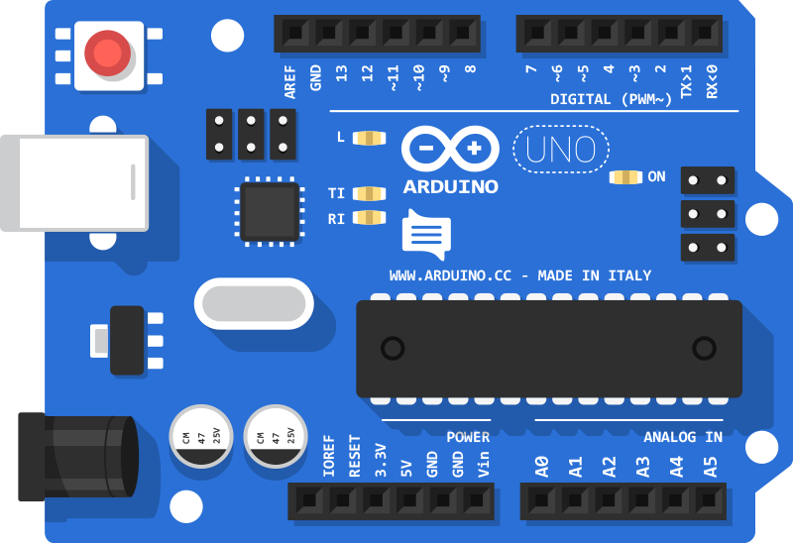
Arduino uno r3
The Arduino Uno is one of the most popular microcontroller boards in the Arduino family. It is widely used for various electronics projects due to its simplicity, ease of use.
Microcontroller: ATmega328P
Operating Voltage: 5V
Input Voltage (recommended): 7-12V
Input Voltage (limit): 6-20V
Digital I/O Pins: 14
Analog Input Pins: 6
Clock Speed: 16 MHz
LED_BUILTIN: 13

Slide 7
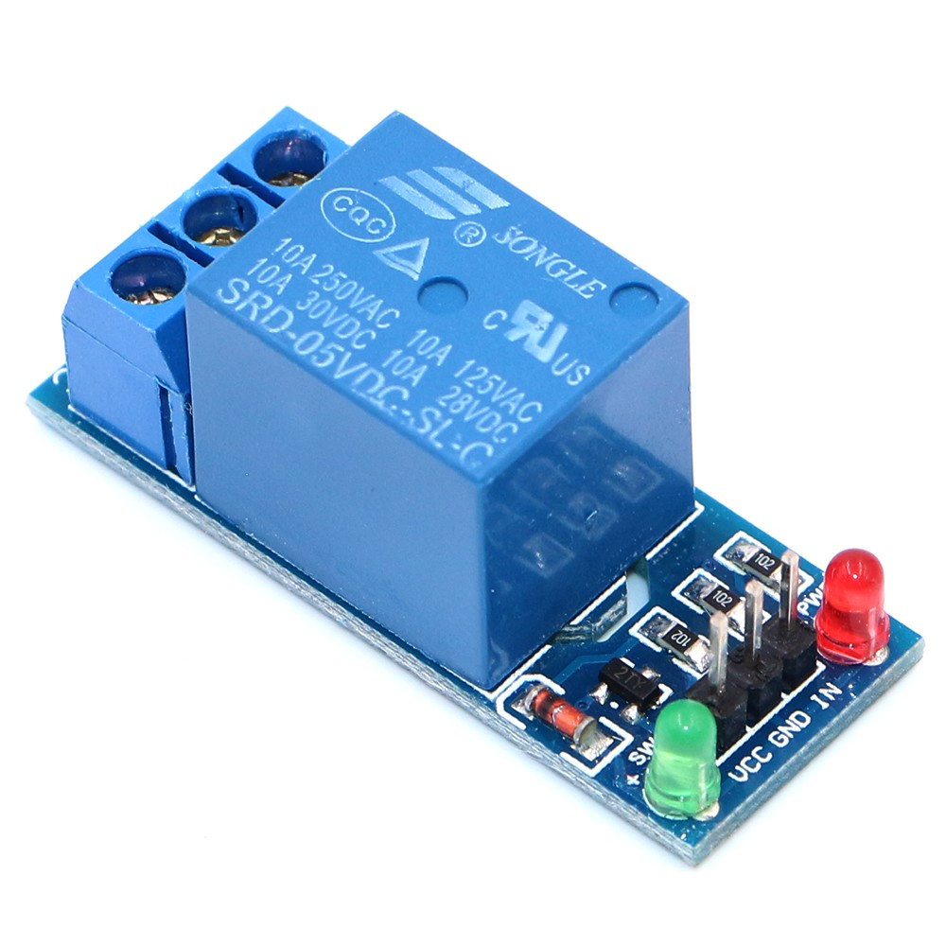
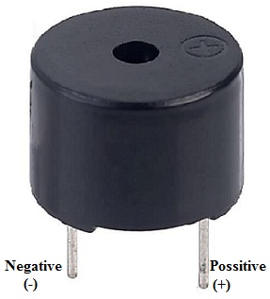
Relay 5v & BUZZER
A 5V relay is an electromechanical switch used to control a circuit with a low-power signal (such as 5V) that can turn on or off a higher-power circuit.
The relay is activated with a 5V signal.
Relays can have different types of contacts, such as Normally Open (NO), Normally Closed (NC), Common, 2 coil (-ve coil, +ve coil).
Buzzers are devices used to produce sound, often used in various applications like alarms, indicators, and notifications.
Buzzers are 2 terminals(+ve terminal,-ve terminal).

Slide 8
20 X 4 LCD & I2C MODULE
A 20x4 LCD refers to a Liquid Crystal Display that has 20 columns and 4 rows. It can display up to 80 characters at a time.
Often includes an LED backlight for visibility in low light conditions.
Usually interfaces via I2C or parallel connection.
Using a 20x4 LCD with an I2C module simplifies the wiring and control process by reducing the number of pins needed.
SDA (Data Line): Connect to the SDA pin on your Arduino (A4 on an Uno).
SCL (Clock Line): Connect to the SCL pin on your Arduino (A5 on an Uno).
VCC: Connect to the 5V pin on your Arduino.
GND: Connect to the GND pin on your Arduino.

Slide 9
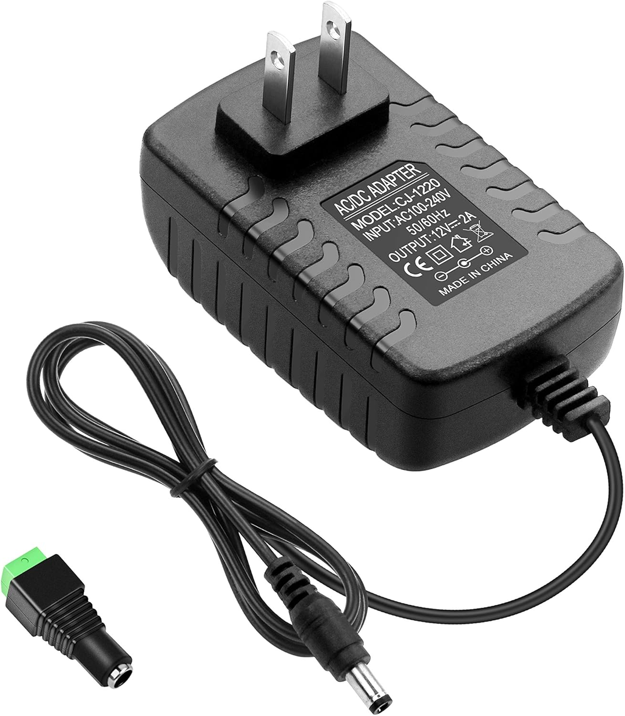
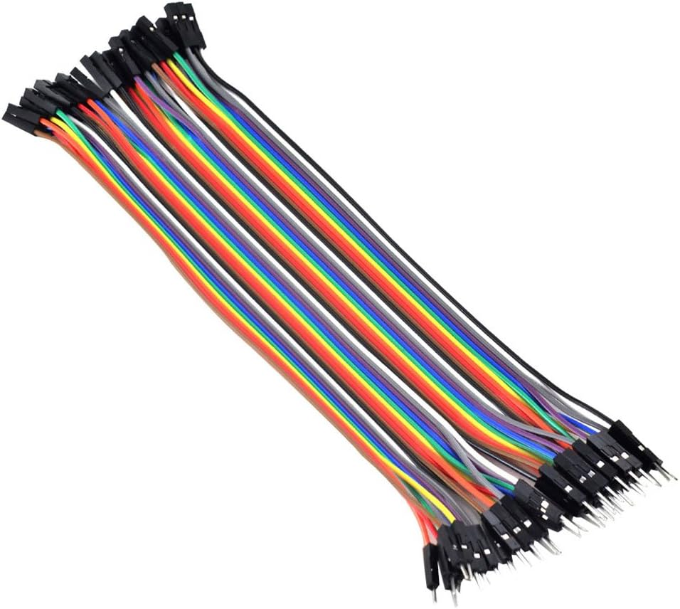
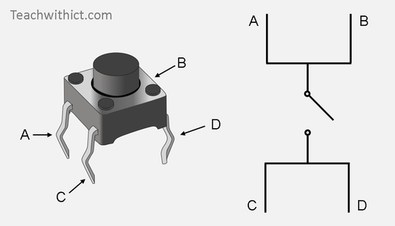

Slide 10
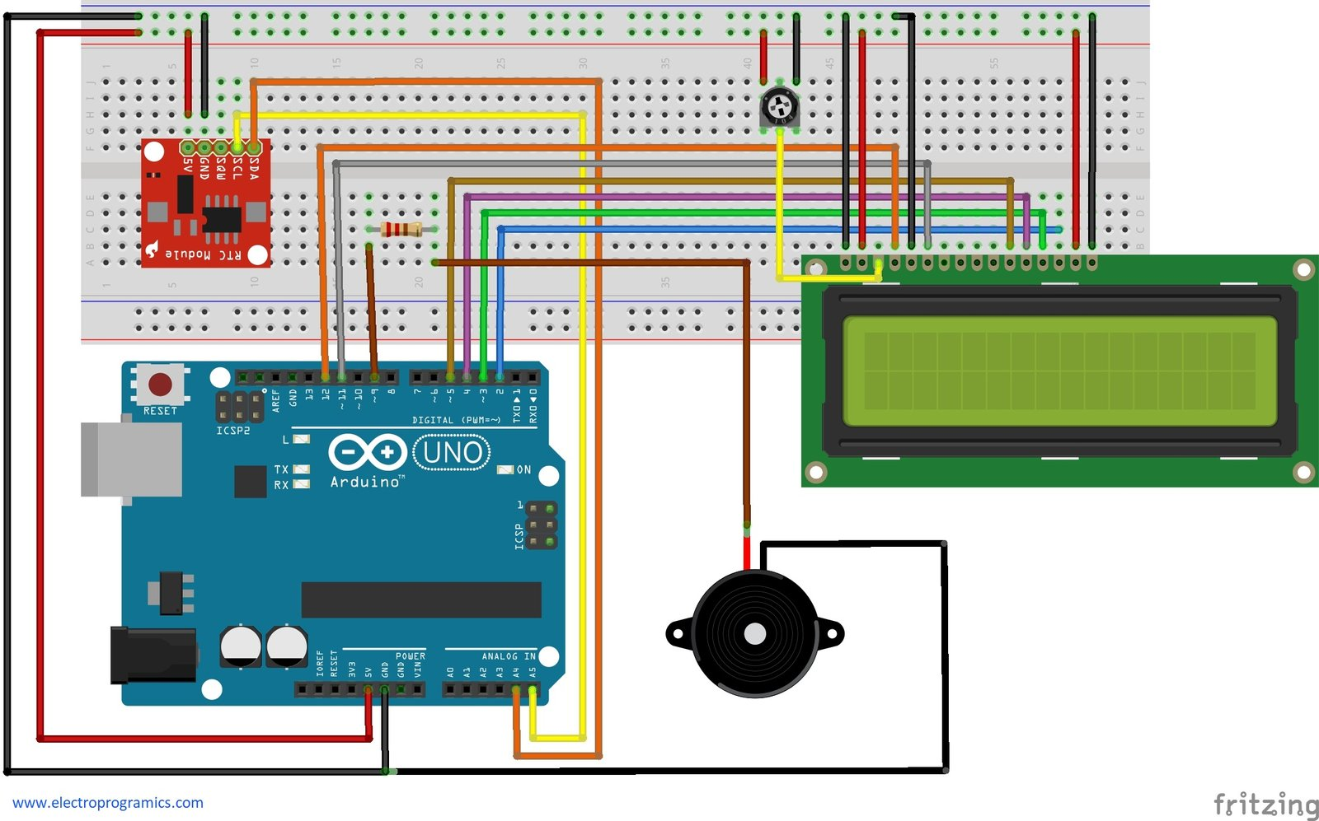
Circuit diagram

Slide 11
Working principle
Timetable Programming: The bell system is programmed with the college timetable, which includes the start and end times of classes, breaks, lunch periods, and any other events.
Internal Clock or Timer: It has an internal clock or timer that keeps track of the current time and day of the week. This is crucial for determining when to activate the bell based on the programmed timetable.
Scheduling Logic: The system uses a scheduling logic to compare the current time with the programmed timetable. It determines which event (class start, class end, break, etc.) is currently scheduled based on the time and date
Timetable Display: Simultaneously or separately, the system displays the current timetable information. This could be on digital displays placed strategically around the college campus, showing the current class period, upcoming events, or any changes to the regular schedule.

Slide 12
ADVANTAGES AND DISADVANTAGES
Efficiency
Convenience
Flexibility
Enhanced Communication
Centralized Control
Cost-effectiveness
Improved Learning Environment
Initial Setup Cost
Maintenance Requirements
Complexity
Dependency on Power
Resistance to Change

Slide 13
LIMITATIONS
Accessibility
Resistance to Change
Potential for Technical Issues
Integration with Existing Systems
Flexibility in Scheduling
User Training
Cost

Slide 14
APPLICATION
Classroom Management
Event Coordination
Emergency Alerts
Announcements and Communication
Facility Management
Data Analysis and Insights

Slide 15
CONCLUSION
In essence, automatic college bells with timetable displays represent a valuable investment for educational institutions seeking to modernize their infrastructure, promote accountability, and create an environment conducive to learning and growth.

Slide 16
THANK YOU

